Slide 1

Lecture 3: Sensors
Topics: Motion/Position/Environment and Location

Slide 2
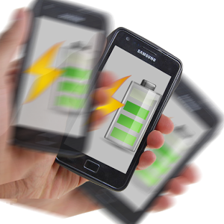
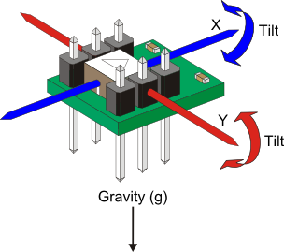


Examples
Motion Sensors
Measure acceleration and rotational forces.
e.g., accelerometers, gravity sensors, gyroscopes, and rotational vector sensors.
Position Sensors
Measure the physical position of a device
e.g., orientation sensors and magnetometers
Environmental Sensors
Measure various environmental parameters
e.g., barometers, photometers, and thermometers.

Slide 3
Types of Sensors
Sensor | HW/SW | Notes | Use
TYPE_ACCELEROMETER | HW | (A_{x}, A_{y}, A_{z}) + g; ms² | Shake, Tilt
TYPE_AMBIENT_TEMPERATURE | HW | ⁰C
TYPE_GRAVITY | SW/HW | g = (g_{x}, g_{y}, g_{z}); ms² | Shake, Tilt
TYPE_GYROSCOPE | HW | ω = (ω_{x}, ω_{y}, ω_{z}) rad/s | Spin, Turn
TYPE_LIGHT | HW | Illumination; lx | Brightness control
TYPE_LINEAR_ACCELERATION | SW/HW | (A_{x}, A_{y}, A_{z}); no g; ms²
TYPE_MAGNETIC_FIELD | HW | (B_{x}, B_{y}, B_{z}) µT | Compass
TYPE_ORIENTATION | SW | 3 axis rotation; matrix | Device position
TYPE_PRESSURE | HW | hPa or mbar | Air pressure
TYPE_PROXIMITY | HW | cm; distant from screen | Phone position
TYPE_RELATIVE_HUMIDITY | HW | humidity (%) | Dew point
TYPE_ROTATION_VECTOR | SW/HW | Device’s rotation vector
TYPE_TEMPERATURE | HW | ⁰C

Slide 4
Types of Sensors
Sensor | HW/SW | Notes | Use
TYPE_ACCELEROMETER | HW | (A_{x}, A_{y}, A_{z}) + g; ms² | Shake, Tilt
TYPE_AMBIENT_TEMPERATURE | HW | ⁰C
TYPE_GRAVITY | SW/HW | g = (g_{x}, g_{y}, g_{z}); ms² | Shake, Tilt
TYPE_GYROSCOPE | HW | ω = (ω_{x}, ω_{y}, ω_{z}) rad/s | Spin, Turn
TYPE_LIGHT | HW | Illumination; lx | Brightness control
TYPE_LINEAR_ACCELERATION | SW/HW | (A_{x}, A_{y}, A_{z}); no g; ms²
TYPE_MAGNETIC_FIELD | HW | (B_{x}, B_{y}, B_{z}) µT | Compass
TYPE_ORIENTATION | SW | 3 axis rotation; matrix | Device position
TYPE_PRESSURE | HW | hPa or mbar | Air pressure
TYPE_PROXIMITY | HW | cm; distant from screen | Phone position
TYPE_RELATIVE_HUMIDITY | HW | humidity (%) | Dew point
TYPE_ROTATION_VECTOR | SW/HW | Device’s rotation vector
TYPE_TEMPERATURE | HW | ⁰C

Slide 5
Android Sensor Framework
Check Availability
What sensors do I have?
Get Information
e.g., maximum range, manufacturer, power requirements, and resolution.
Get Values
e.g., raw sensor data, minimum rate.
Register/unregister for Sensor Events

Slide 6
Four Relevant Classes
SensorManager:
Create an instance of the sensor service.
Accessing and listing sensors.
Registering and unregistering sensor event listeners.
Report sensor accuracy, set data acquisition rates, and calibrate sensors.
Sensor:
Create an instance of a specific sensor.
Determine a sensor's capabilities.

Slide 7
Four Relevant Classes
SensorEvent
Carries information about a sensor event:
Raw data, sensor type, accuracy, timestamp
SensorEventListener
Two callback methods that receive notifications:
onSensorChanged() and onAccuracyChanged()

Slide 8
Working with Sensors
Step 1: Get the SensorManger from system services.
Step 2: Get the Sensor (or a list) from the manager.
private SensorManager sm; private Sensor s; private List<Sensor> l;
sm = (SensorManager) getSystemService
(Context.SENSOR_SERVICE);
l = sm.getSensorList(Sensor.TYPE_ALL);
s = sm.getDefaultSensor(Sensor.TYPE_LIGHT);
Returns “null” if no light sensor

Slide 9
Working with Sensors
Step 3 (optional): Get information about a Sensor.
s.getName(); s.getMaximumRange(); s.getResolution(); s.getMinDelay(); s.getPower(); s.getVendor(); s.getVersion();

Slide 10
Working with Sensors
Step 4: Implement and Register SensorEventListener
public class MainActivity extends AppCompatActivity implements SensorEventListener{ private SensorManager sm; private Sensor s; private List<Sensor> l; @Override protected void onCreate(Bundle savedInstanceState) { super.onCreate(savedInstanceState); setContentView(R.layout.activity_main); sm = (SensorManager) getSystemService(Context.SENSOR_SERVICE); l = sm.getSensorList(Sensor.TYPE_ALL); s = sm.getDefaultSensor(Sensor.TYPE_LIGHT); sm.registerListener(this, s, 1000000); } @Override public void onSensorChanged(SensorEvent event) { } @Override public void onAccuracyChanged(Sensor sensor, int accuracy) { } }

Slide 11
Good Practices:
Check sensor before using.
Declare <uses-feature> in the manifest.
Unregister at onPause(), register at onResume().
if(sm.getDefaultSensor(Sensor.TYPE_LIGHT) == null) { //Display sensor not available message. }
<uses-feature android:name="android.hardware.sensor.accelerometer" android:required="true" />
@Override protected void onPause() { super.onPause(); sm.unregisterListener(this); } @Override protected void onResume() { super.onResume(); sm.registerListener(this, s, 1000000); }

Slide 12
Good Practices:
Don’t block onSensorChanged()
Choose sensor delays carefully.
@Override public void onSensorChanged(SensorEvent event) { //Not a place to solve an NP-hard problem here. }

Slide 13
Code Practice:
Show a list of available sensors on the device.
Get Gravity Sensor readings.
Report them at 1 second interval.
Now, add another sensor, e.g., Light Sensor.
Report light sensor at 0.5 second interval.

Slide 14
Location Sensing
Topics: Google Play Services, Location API

Slide 15
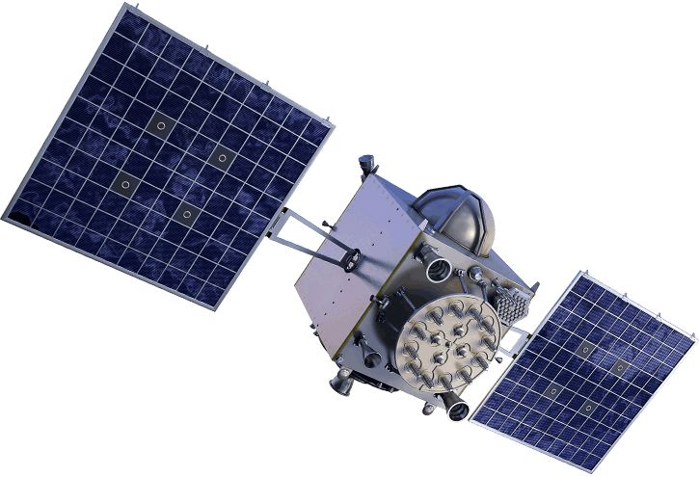
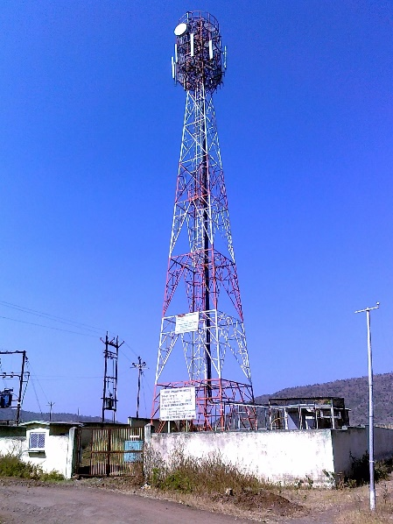
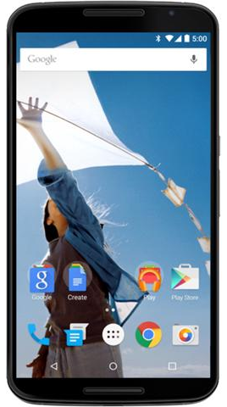
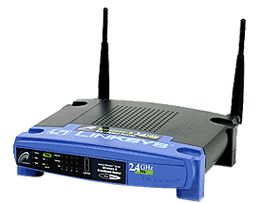
Location Estimation
GPS
Cellular
WiFi

Slide 16



Location Estimation
12
10
7

Slide 17
Location Estimation
12
10
7

Slide 18
Two API Options
Android API (not rich enough)
Google Play Services Location API (better)
Tracking
Geofencing
Activity Recognition (walking, biking, driving …)

Slide 19
Making Your App Location Aware
0. Setup Google Play/Dependencies/Permissions…
Getting Last Known Location
Usually the same as the current location
Changing Location Settings
Detect and apply system settings for location features
Receiving Location Updates
Request and received periodic location updates
Displaying a Location Address
Converting long/lat to an address (reverse geocoding)
Creating and Monitoring Geofences
Defining and dealing with geofences and user locations

Slide 20
0. Setup Google Play Location Services¹
Install Google Play Services
SDK Manager > SDK Tools
Select Google Play Services, Check, Apply.
Edit build.gradle (Module:app)
Add new dependency and Sync.
Specify permission in AndroidManifest.xml
Goes inside <manifest> but outside <application> tag.
implementation 'com.google.android.gms:play-services-location:16.0.0'
<uses-permission android:name="android.permission.ACCESS_FINE_LOCATION"/>
¹For more details – Setting Up Google Play Services: https://developers.google.com/android/guides/setup

Slide 21
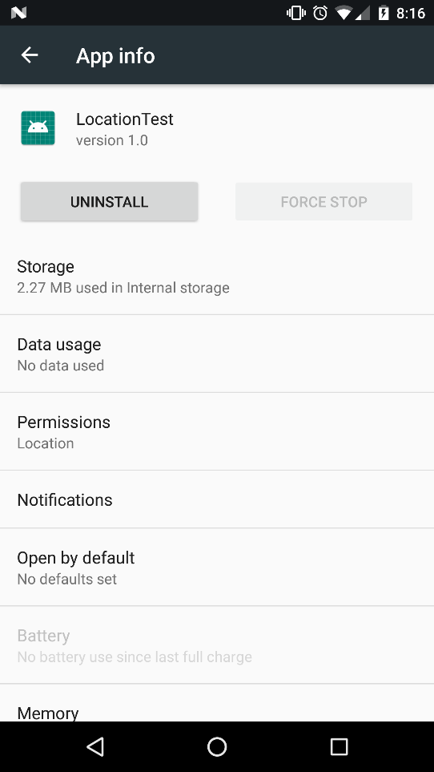
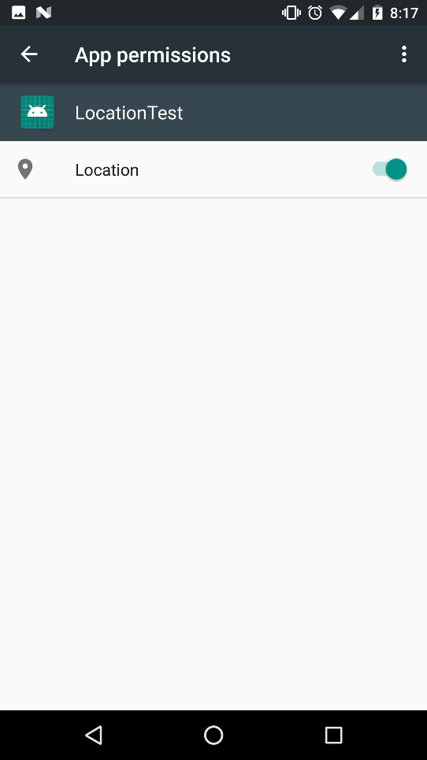
0. Setup Google Play Location Services¹
4. Enable Location Permission
Your phone’s Settings>Apps>Your_Location_App
Turn on the “Location” permission.

Slide 22
1. Getting Last Known Location
Use FusedLocationProviderClient
private FusedLocationProviderClient client = null; @Override protected void onCreate(Bundle savedInstanceState) { super.onCreate(savedInstanceState); setContentView(R.layout.activity_main); client = LocationServices.getFusedLocationProviderClient(this); try { client.getLastLocation().addOnSuccessListener(this, new OnSuccessListener<Location>() { @Override public void onSuccess(Location location) { //Do something with the last location } }); }catch (SecurityException ex){ Log.v("MyTAG", ex.toString()); } }

Slide 23
Code Practice
Setup App (Google Play Location Services etc.)
Connect to the Location Service
Print the location: lat/long
Show the location on a map (using Intent)

Slide 24

2. Set Up a Location Request
Preferred Rate
Max Rate
Priority
Your
Location
App
(lat, long)
App #1
Pref: 100 ms
Max: 20 ms
App #2
Pref: 50 ms
Max: 30 ms

Slide 25
2. Set Up a Location Request
Preferred Rate
Max Rate
Priority
Your
Location
App
(lat, long)
Priority | Accuracy | Power | Approach
PRIORITY_BALANCED_POWER_ACCURACY | 100m (block) | Low | WiFi+Cell
PRIORITY_HIGH_ACCURACY | 10m | High | GPS
PRIORITY_LOW_POWER | 10 km (city) | Low
PRIORITY_NO_POWER | - | Negligible | Other apps
Potential Research Topic

Slide 26
2. Set Up a Location Request
Step 2.1: Create a LocationRequest object
Step 2.2: Check current settings.
Step 2.3: Prompt the user to change settings.
LocationRequest req = new LocationRequest();
req.setInterval(10000); //preferred rate
req.setFastestInterval(5000); //max rate it can handle
req.setPriority(LocationRequest.PRIORITY_HIGH_ACCURACY);

Slide 27
3. Receive Location Updates
Step 3.1: Use the client to request periodic updates
Step 3.2: Start and stop requesting.
https://developer.android.com/training/location/request-updates
client.requestLocationUpdates(req, new LocationCallback(){ @Override public void onLocationResult(LocationResult locationResult) { super.onLocationResult(locationResult); Log.v("MyTag", "Current Location: "); } }, getMainLooper());

Slide 28
4. Displaying a Location Address
Geocoder
getFromLocation() | Input: Output: | 35.9001114, -79.0672419 0:”1100 N Carolina 54” 1:"Chapel Hill, NC 27516“ 2:"USA"
getFromLocationName() | Input: Output: | Sitterson Hall 0:"UNC Sitterson Hall", 1:"Chapel Hill, NC 27514", 2:"USA"
….

Slide 29
4. Displaying a Location Address
Goecoder converts Lat/Long to an Address
Geocoder g = new Geocoder(this, Locale.getDefault());
try { List<Address> la = g.getFromLocation(location.getLatitude(), location.getLongitude(), 1);
Log.v("Address", la.get(0).toString());
}catch (Exception ex) { }
Warning: This may take a long time.
Use a background service or AsyncTask or a Thread.

Slide 30
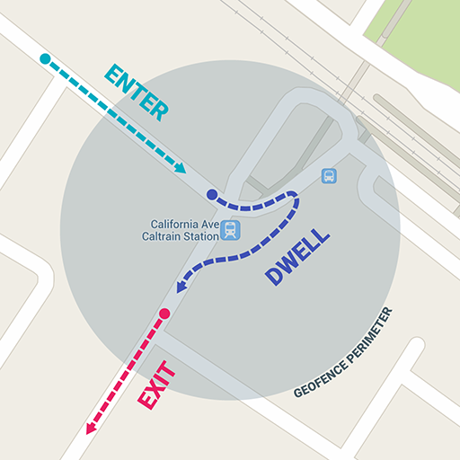
5. Geofencing
Geofencing combines awareness of the user's current location with awareness of the user's proximity to locations that may be of interest.
Lat, Long, and Radius (m)
100 geofences per device user
Events:
Entry
Exit
Dwell (specify duration)
Expiration (ms)
Use:
Advertisement
Coupons
Avoid dangerous area

Slide 31
Code Practice
Get location updates (lat, long)
Print the Address!

Slide 32
References
https://developer.android.com/guide/topics/sensors/sensors_overview
https://developer.android.com/guide/topics/sensors/sensors_motion
https://developer.android.com/guide/topics/sensors/sensors_position
https://developer.android.com/guide/topics/sensors/sensors_environment
https://www.quora.com/What-are-all-the-sensors-used-in-smartphones-and-explain-its-purpose-and-its-working

